Slide 2


Analysis of FPAs in the LHC RB circuit
Christoph Obermair, TE-MPE-CB Lukas Felsberger, TE-MPE-MI Franz Pernkopf, TU-Graz Andrea Apollonio, TE-MPE-CB Daniel Wollmann, TE-MPE-CB

Slide 3
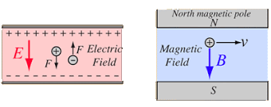
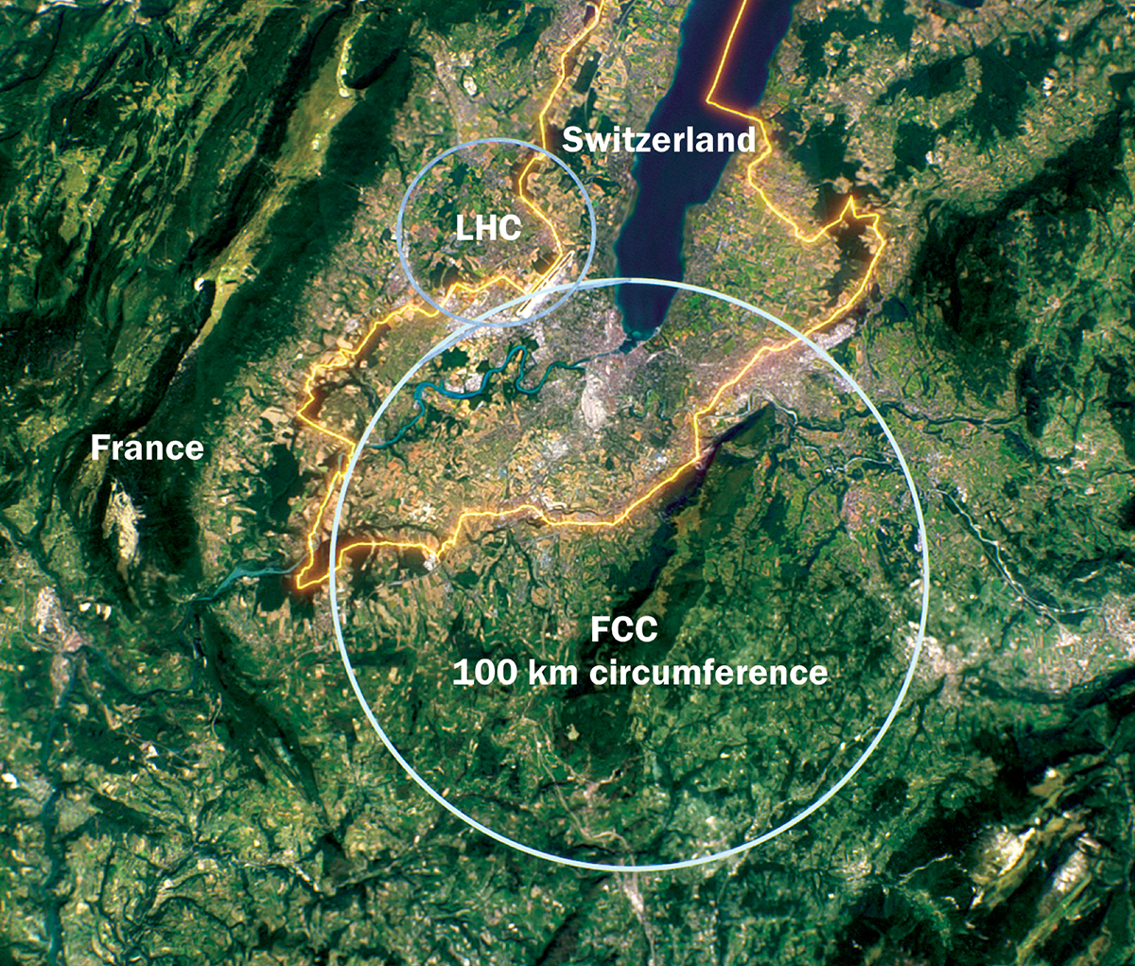
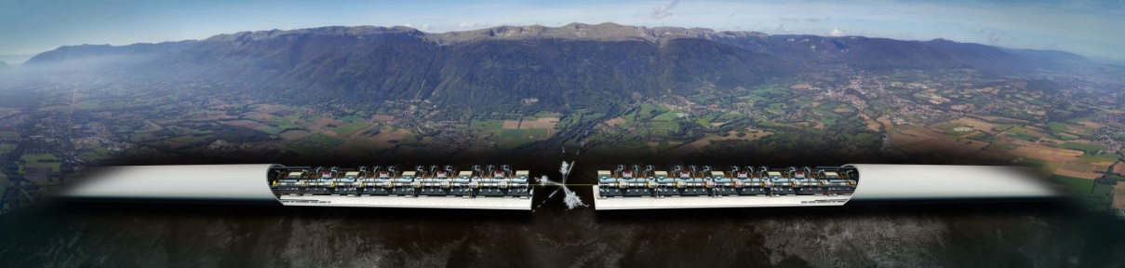
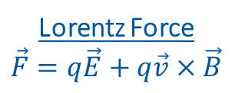
Introduction to Accelerators
Principle: Accelerate particles with electric field, and analyze collissions with target.
Types:
Linear accelerators - Linear accelerator 4 (Linac4)
Limitation to high collission energy is electric field
Breakdowns can destry radio frequency cavities
Circular accelerators - Large Hadron Collider (LHC)
Limitation to high collission energy is electric field
Quenches can destroy magnets
Current LHC status: LHC page 1
Lorentz Force
$$\vec{F}=q\vec{E}+q\vec{v}×\vec{B}$$
CLIC concept image

Slide 4
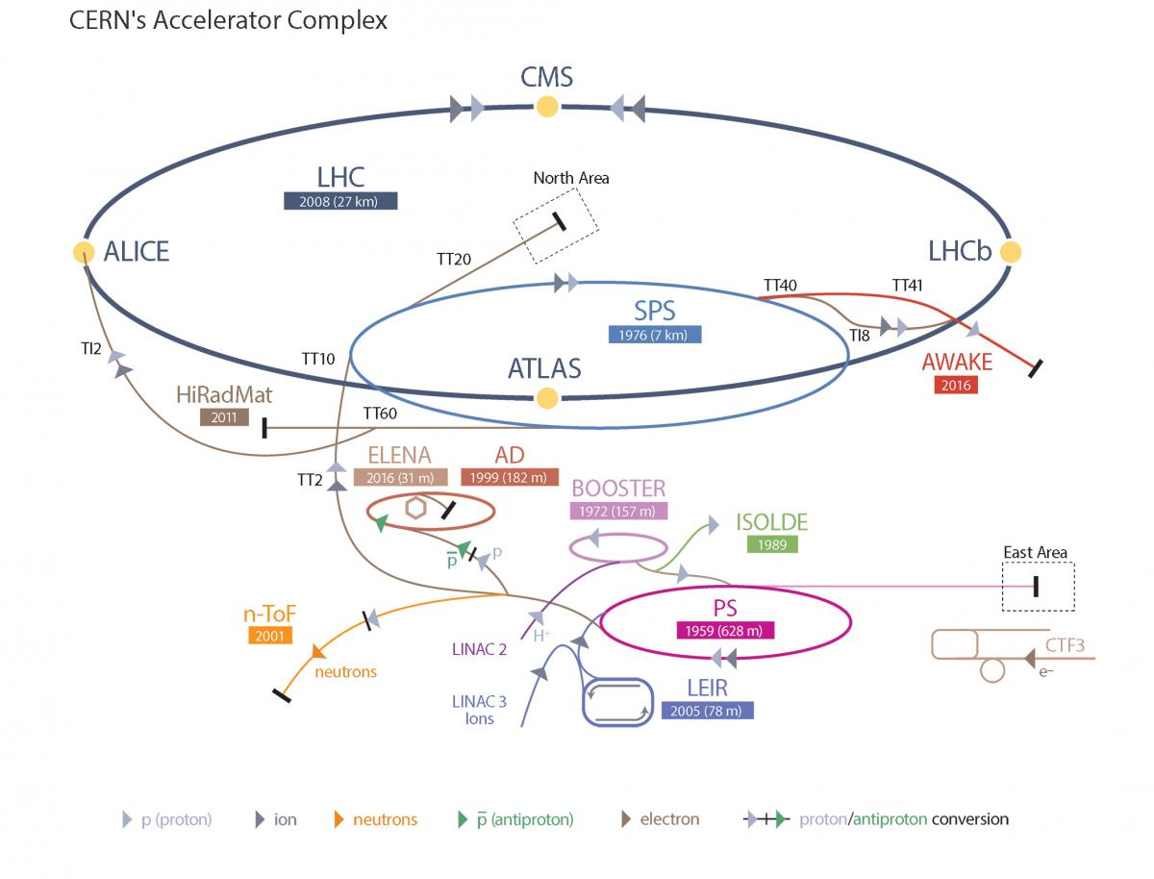
Large Hadron Collider - LHC
LHC Facts
Cost of the LHC | 4332 MCHF
Length | 26 659 m
Dipole operating temperature | -271.3°C
Cost per magnet | ~ 1 MCHF
Number of main dipoles | 1232
Power consumtion | 1.3 TWh/a
Number of circuits | 8
Stored energy per circuit | 1.1 GJ (380-ton TGV @ 50km/h)
10/18/2022

Slide 5
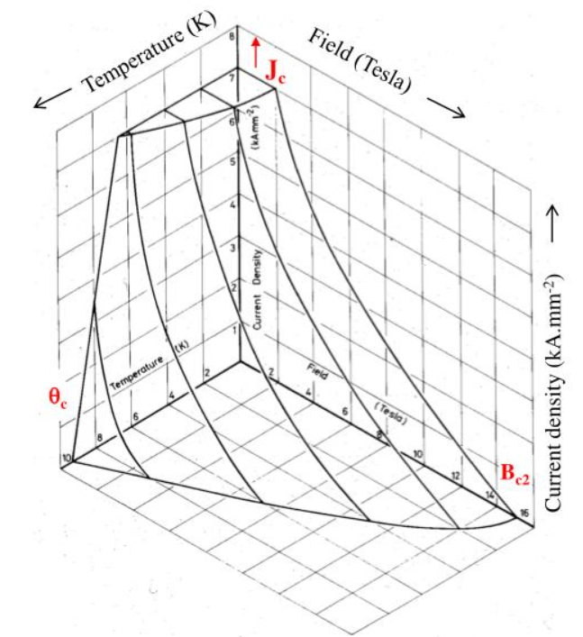
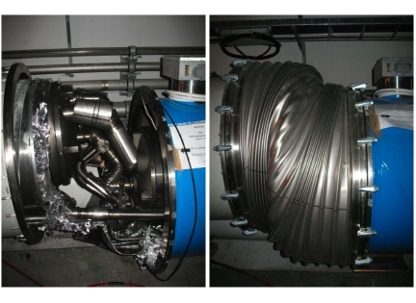
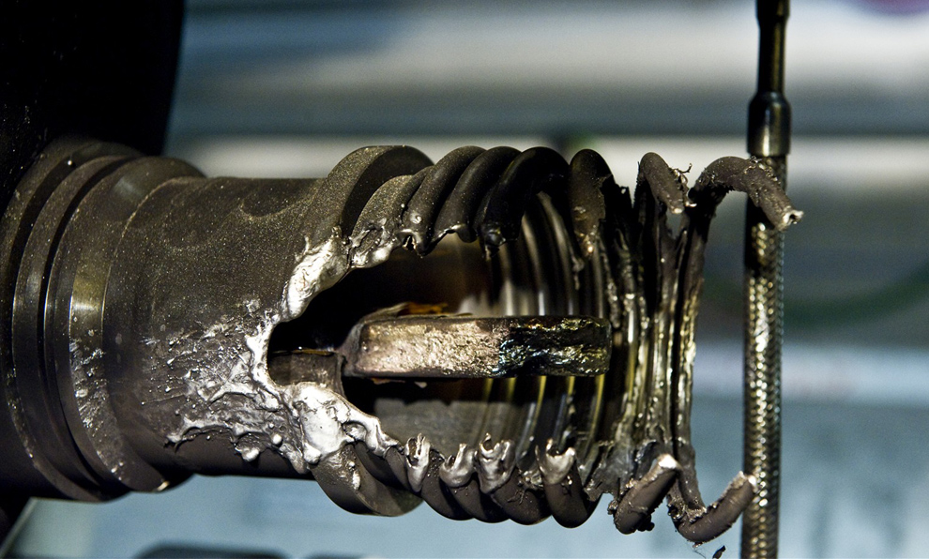
Quench Protection
Quench is biggest threat to LHC dipole magnets
Different types of quench:
Primary quench
Secondary quench: GHe propagation, EM disturbance,..
Quench Protection:
Bypass Diode
Quench Heater
Quenches with destructed magnets:
2008 (~100 destroyed magnets – splice opened)
2021 HWC (1 destroyed magnet - interturn short in coil)
Possible precursor detected 1 month before
Goal: Further precursors?
Critical surface NbTi

Slide 6
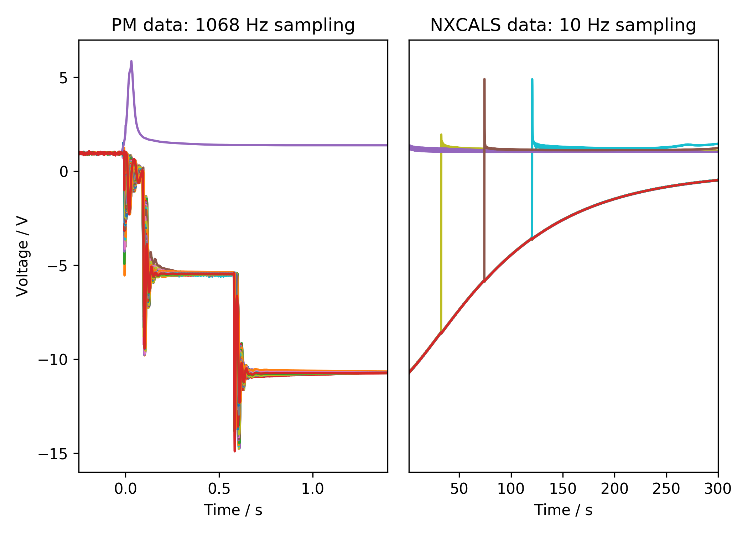
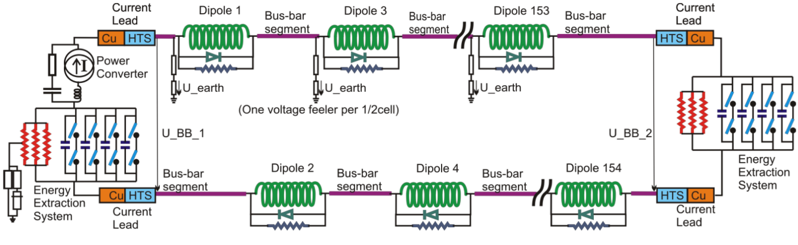
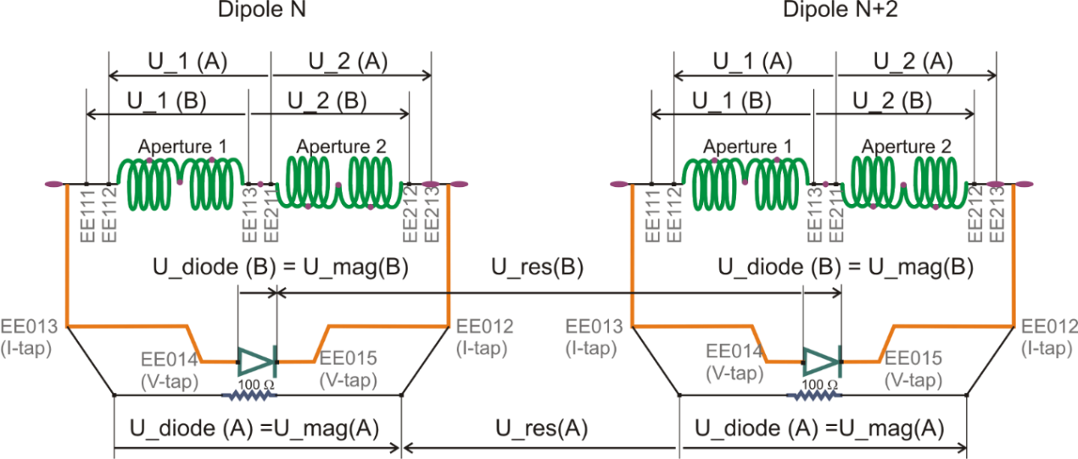
Quench Protection: U-Diode
Interesting area
2nd EE switch off
Secondary quench
1st EE switch off
PC Switch off

Slide 7
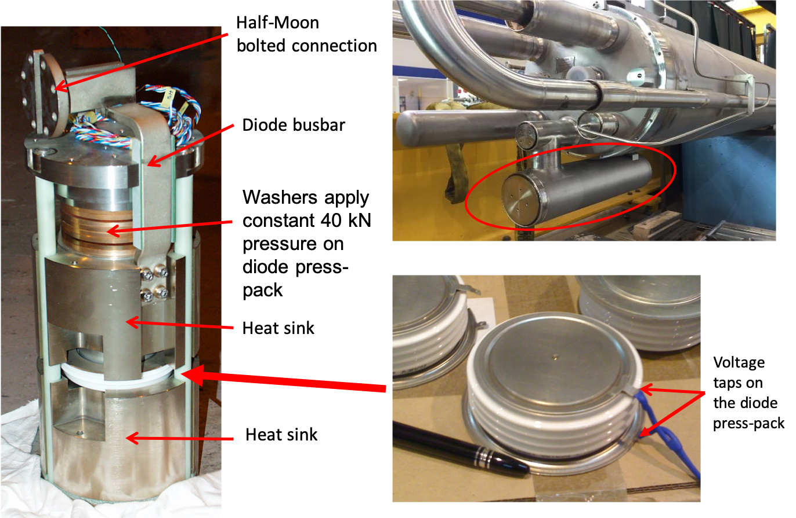
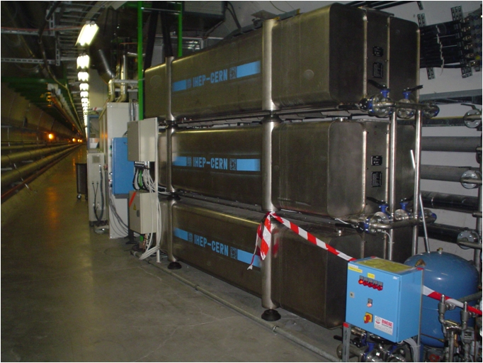
Hardware
Diode
Energy Extraction Resistance

Slide 8
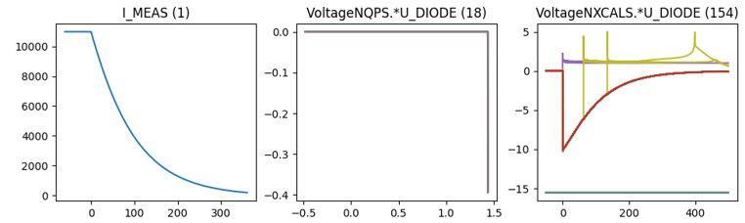
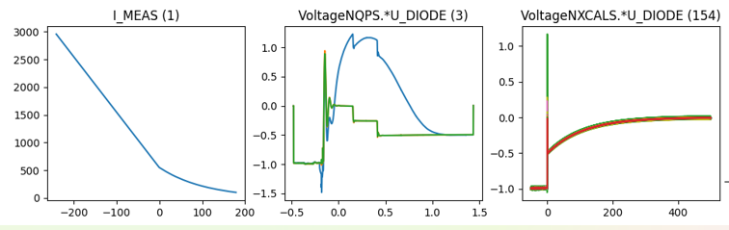
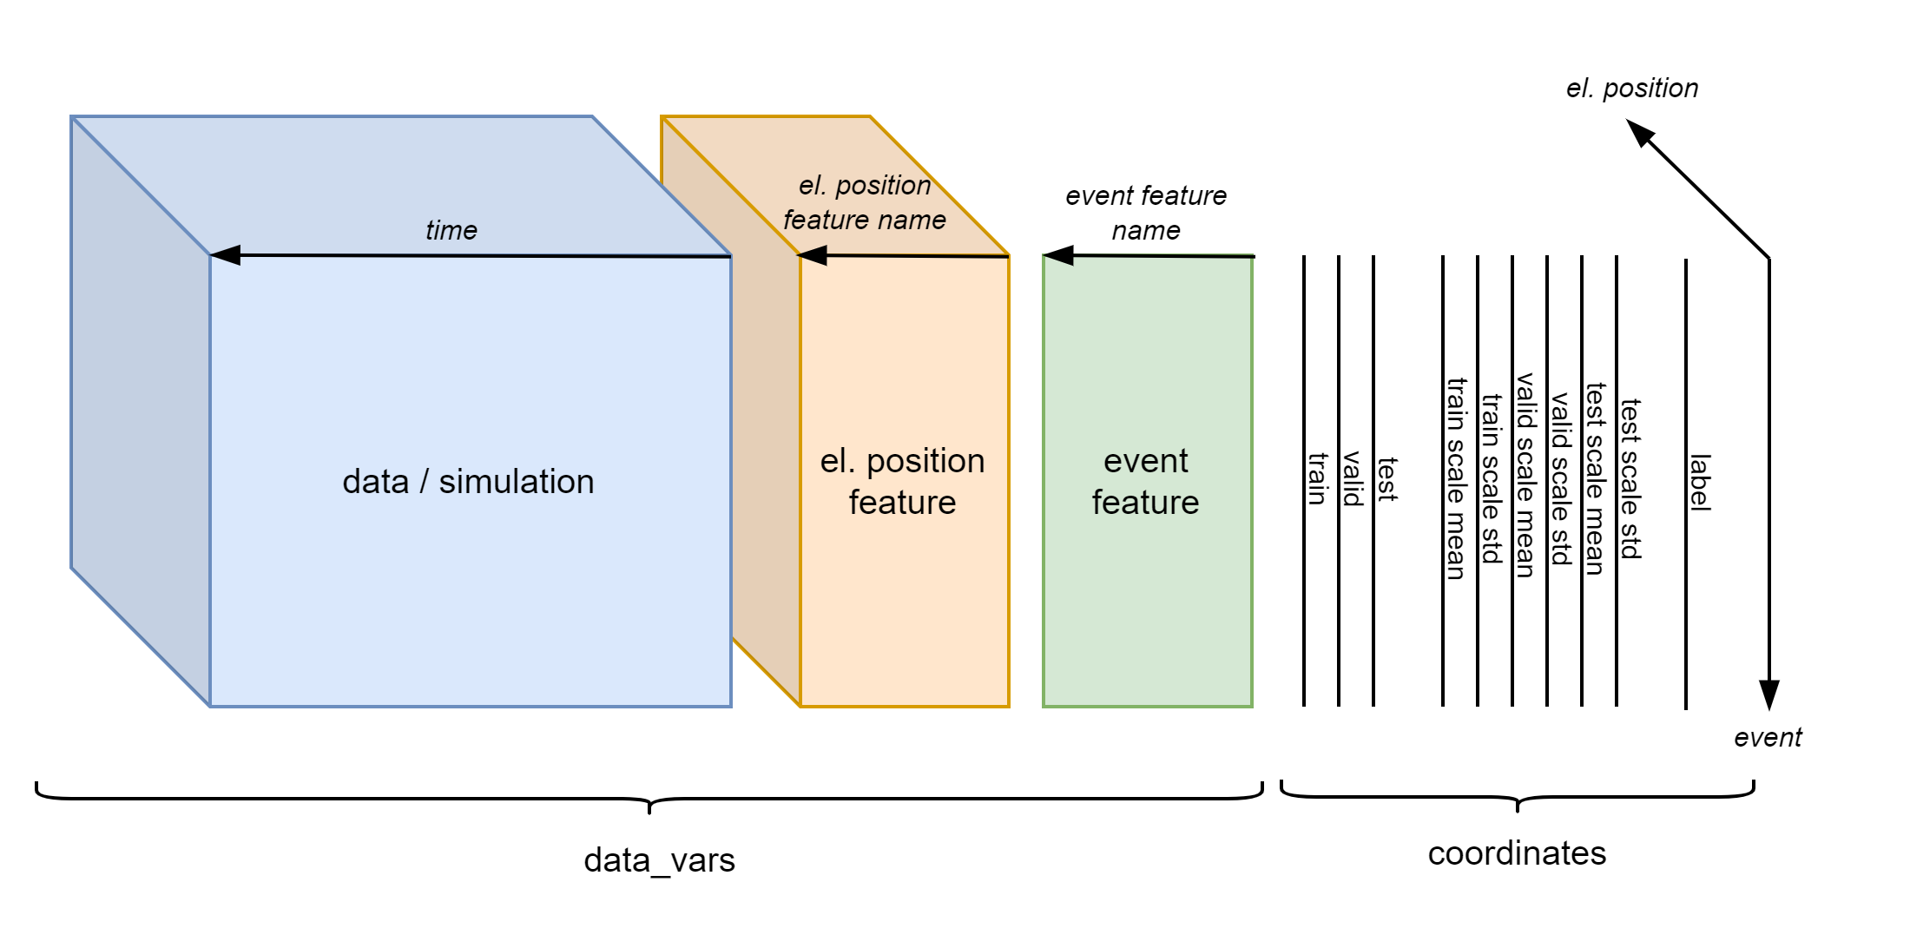
Existing Database Overview
Data overview
Filtered events
 | Signal | 2014-2020 | 2021 | # events
Real Data | U_DIODE_NXCALS | P | P | 867
 | U_DIODE_PM | P | P | 629
 | I_MEAS | P | P | 896
 | U_QSO, U_1, U_2 | P | P | 893
 | I_EARTH_PCNT | P | P | 895
 | I_EARTH | P | P | 629
 | I_HDS, U_HDS | P | P | 896
 | EEUDumpResPM | P | P | 896
Simulations | V(0v_magf*) | P | P | 875
 | I(r1_warm) | P | P | 875
 | V(10,11), V(18,19) | P | P | 875
#events |  | 267 | 629 | 560/896

Slide 9
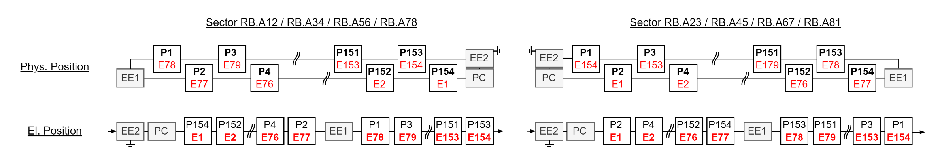
El. Vs Phys. Position

Slide 10
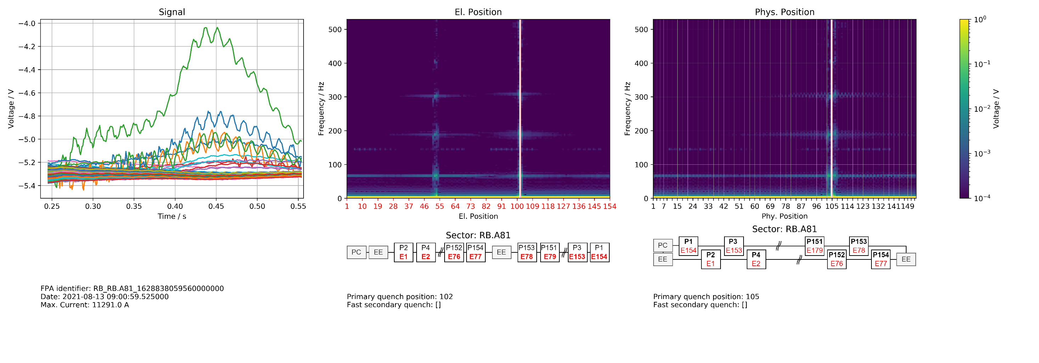
Position Frequency Map

Slide 11
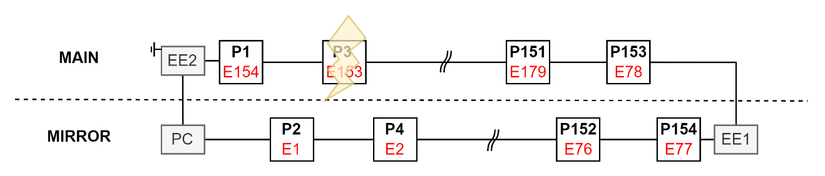
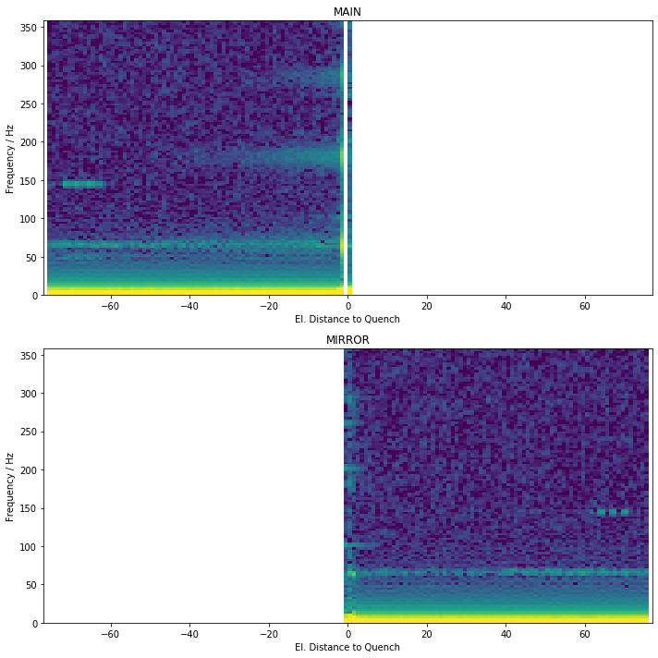
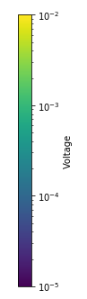
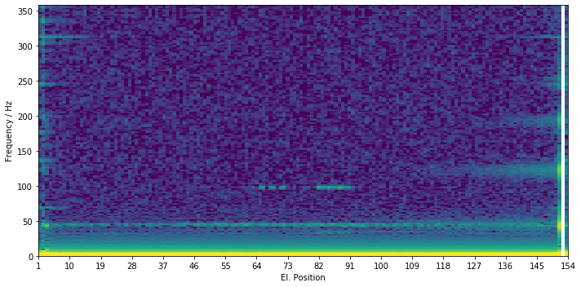
Generalization
To calculate statistics, quench must occur at same position
Not consider events with secondary quenches
Split into
MAIN: Half where quench occurred
MIRROR: Other Half

Slide 12
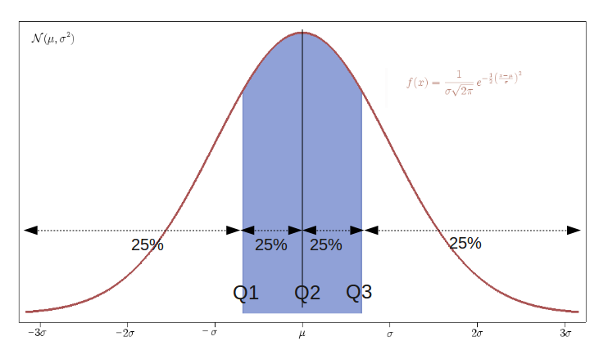
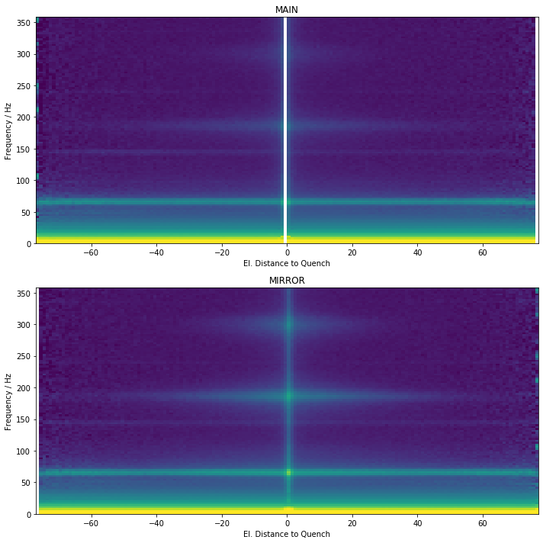
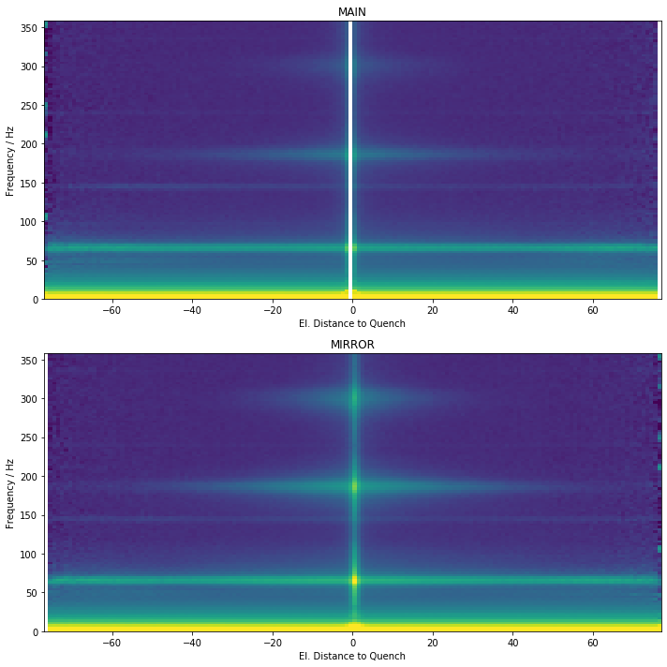
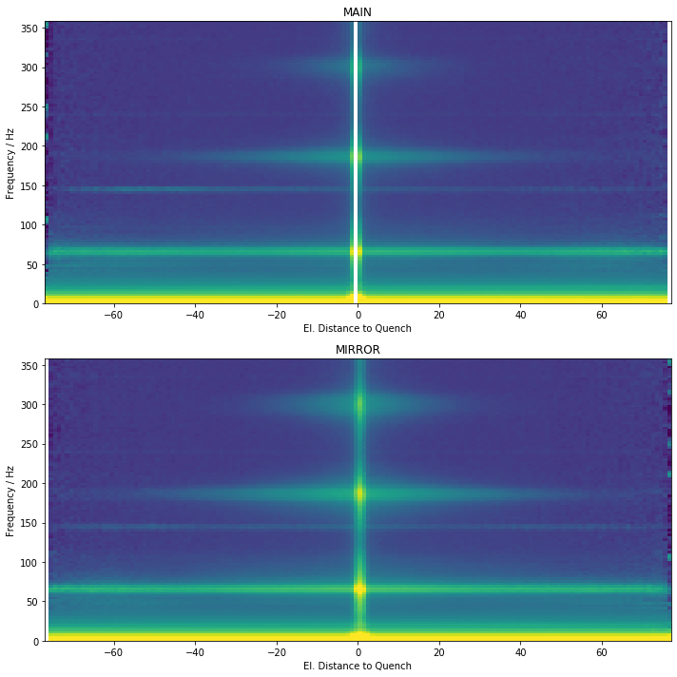
Quantils

Slide 13
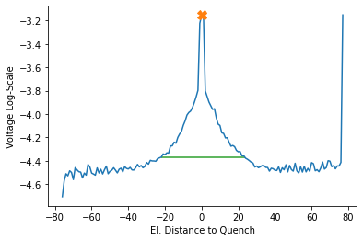
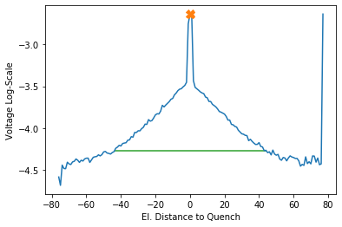
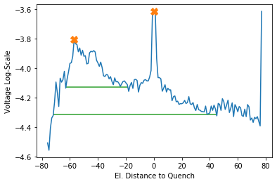
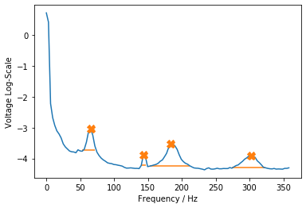
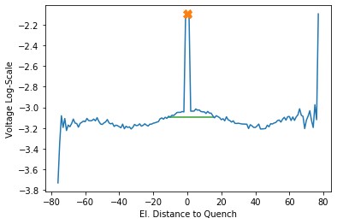
Find Peaks
302.1 Hz
183.8 Hz
143.3 Hz
65.4 Hz

Slide 14
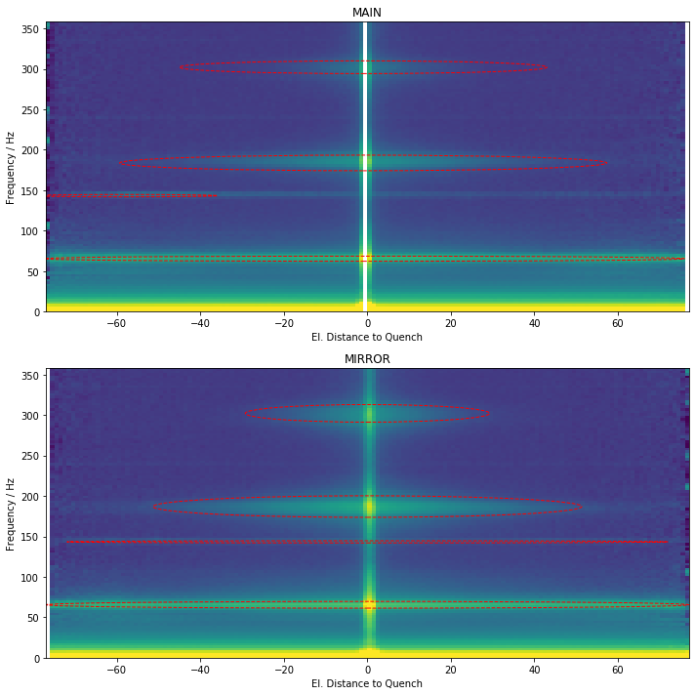
Find Peaks

Slide 15
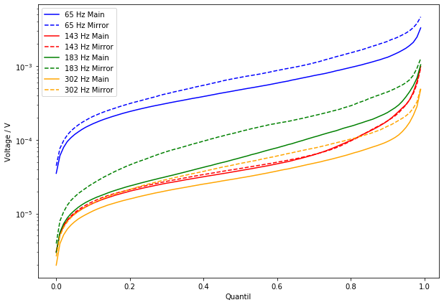
Voltage = f(Quantil)

Slide 16
Sanity Checks

Slide 17
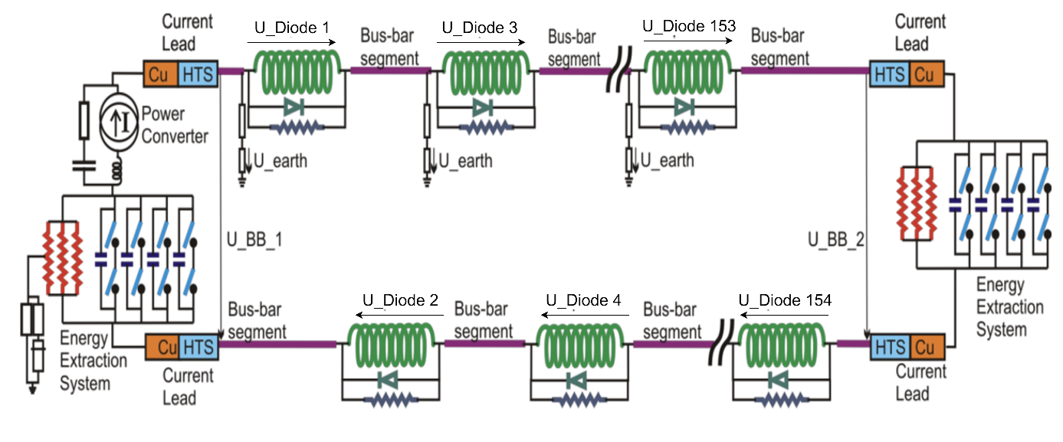
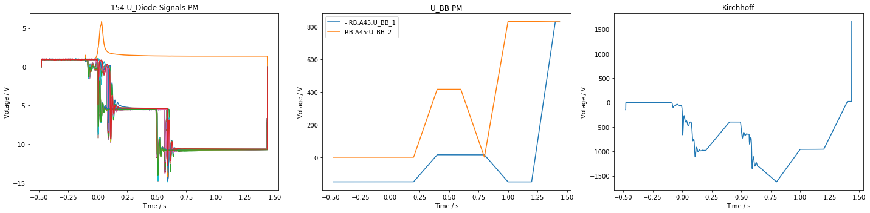
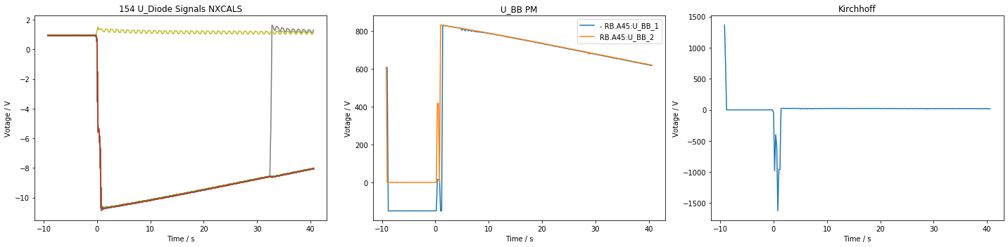
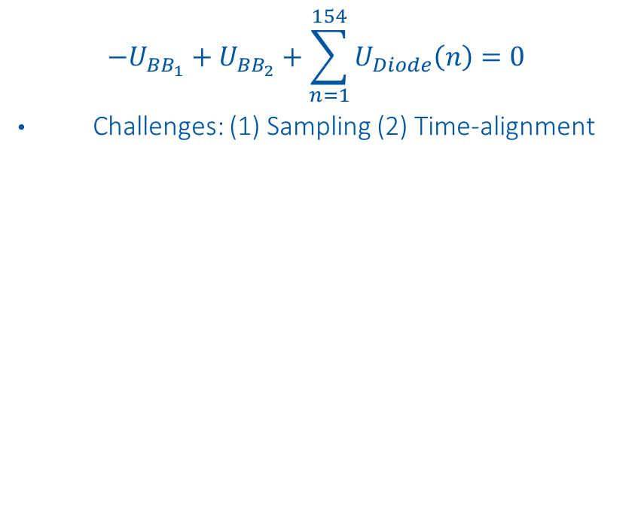
Kirchhoff
$$−U_{BB_{1}}+U_{BB_{2}}+\sum_{n=1}^{154}{U_{Diode}\left(n\right)}=0$$
Challenges: (1) Sampling (2) Time-alignment

Slide 18
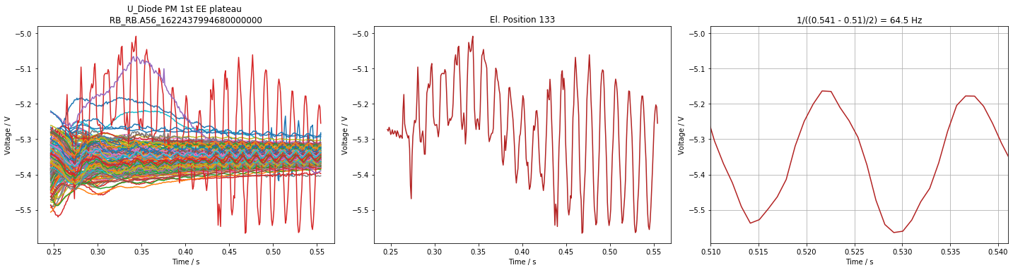
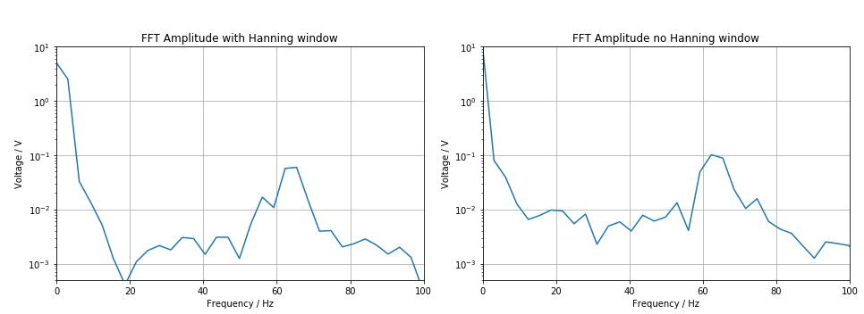
FFT sanity check

Slide 19
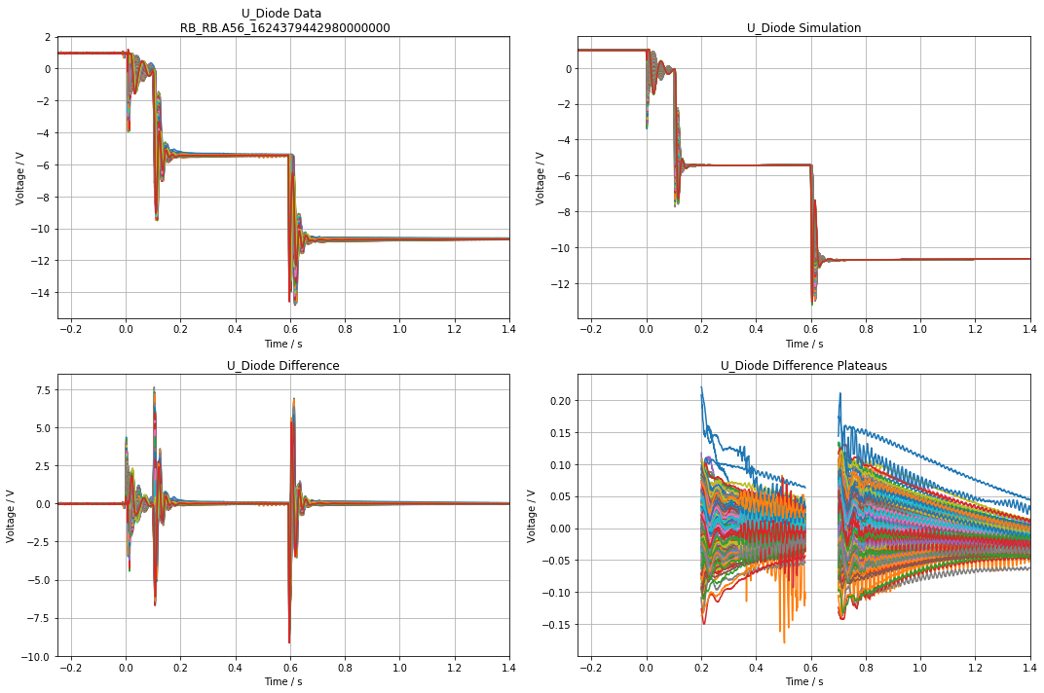
Data - Simulation

Slide 20
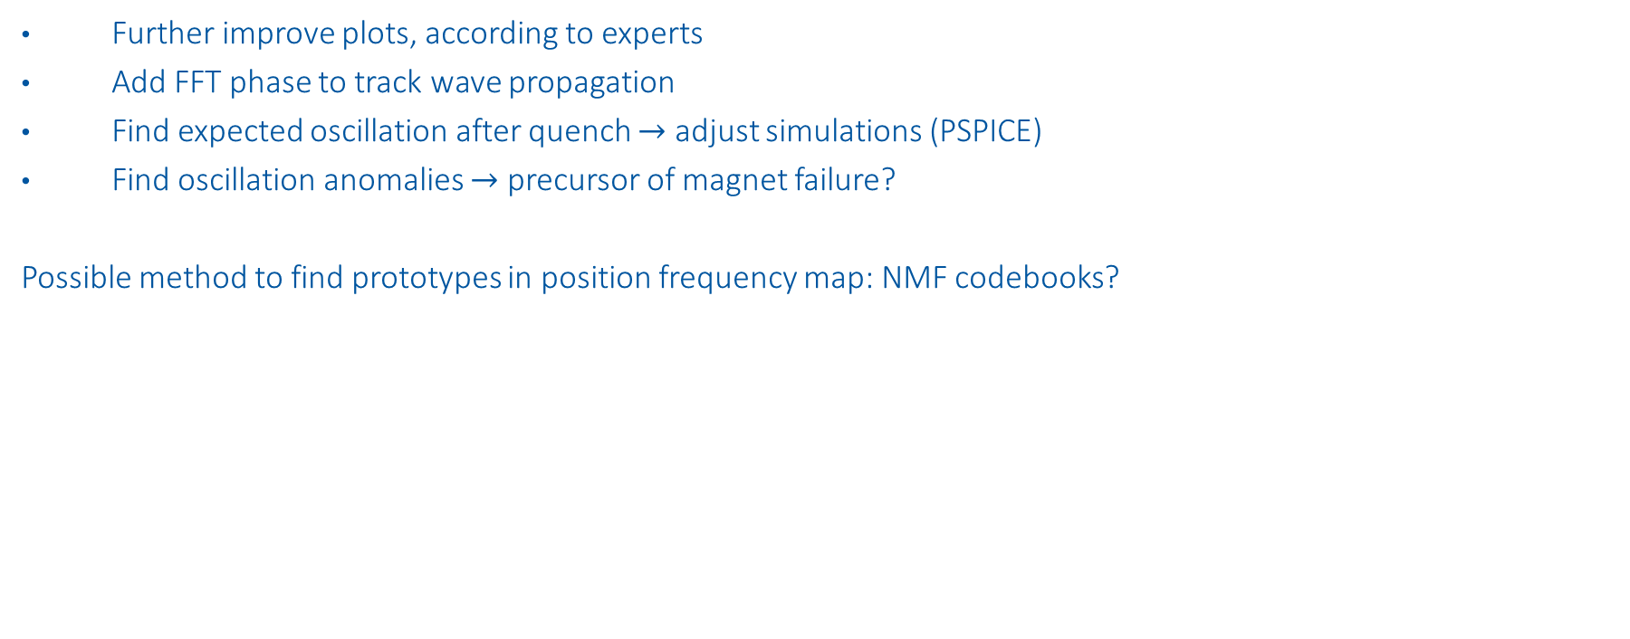
Next Steps
Further improve plots, according to experts
Add FFT phase to track wave propagation
Find expected oscillation after quench $→$ adjust simulations (PSPICE)
Find oscillation anomalies $→$ precursor of magnet failure?
Possible method to find prototypes in position frequency map: NMF codebooks?

Slide 22
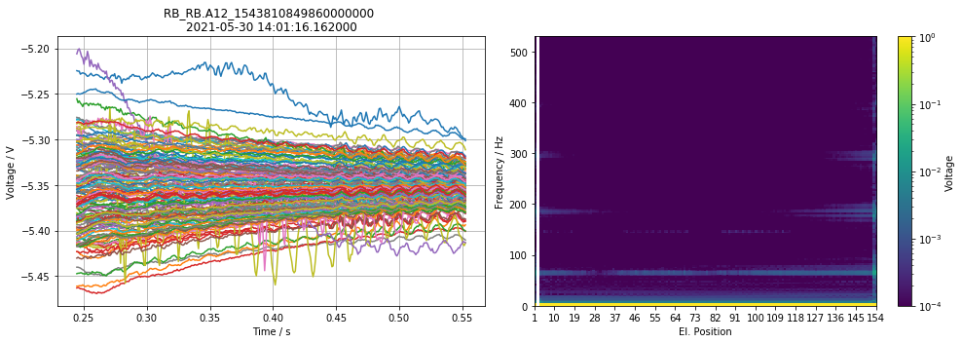
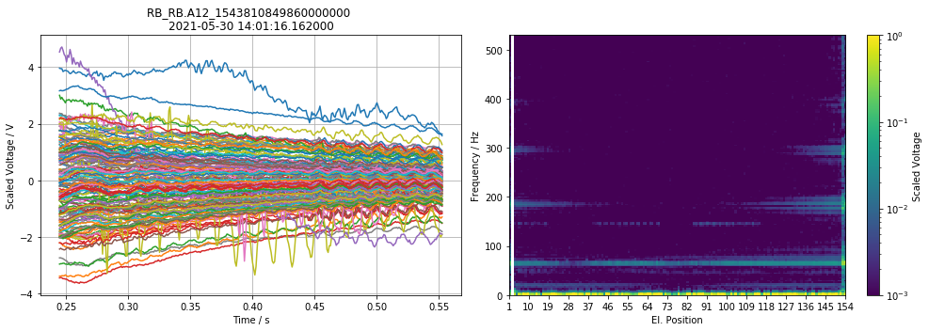
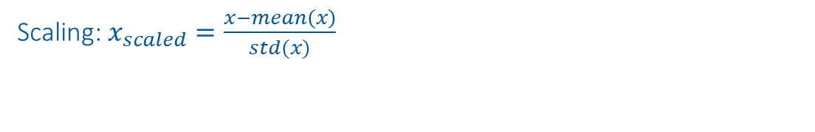
Signal vs. scaled signal
Signal
Scaling: $x_{scaled}=\frac{x−mean\left(x\right)}{std(x)}$
Scaled Signal

Slide 23

Overview of Data-Driven Models
High incorporation of knowledge and context
Data-Driven Models
Manual Feature Engineering
Manual Threshold
Probabilistic
Classic Machine Learning
Automatic Feature Eningeering
Discriminative Deep Learning
Generative Deep Learning
GAN, RNN, ProtoNET
MLP, DCNN, FCN
SVM, Random Forrest, MLP
e.g. Busbar Resistance
e.g. QH Analysis
Fully data driven
Physical Models
Dataset | 1. Feature analysis | 2. Find probabilities/correlations | 3. Finding concepts | 4. Predict parameters | 5. Generate data
1. U Diode Secondary Quench | Oscillation types | Oscillation evolvement
2. U Diode Primary Quench | Oscillation types | Oscillation evolvement | tSNE concepts | Predict sec. quench
3. U Diode Full Quench |  |  |  | Fit simulations | Reconstruct data

Slide 24
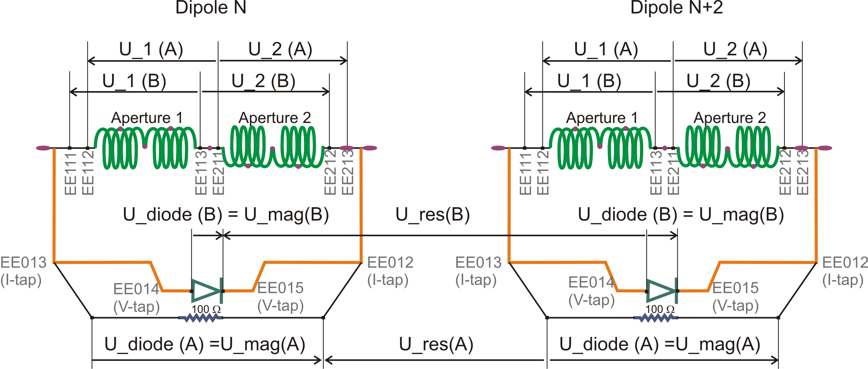
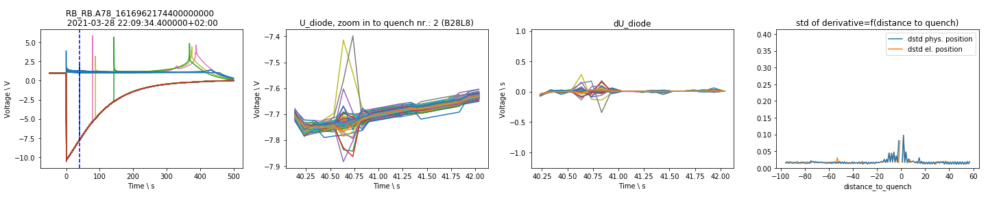
1. U Diode Secondary Quench

Slide 25
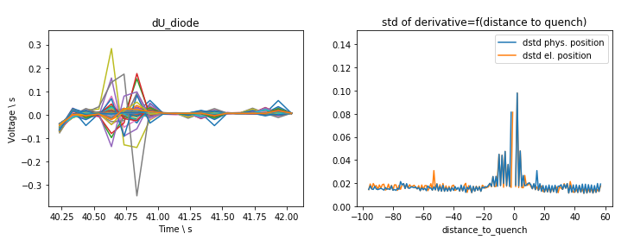
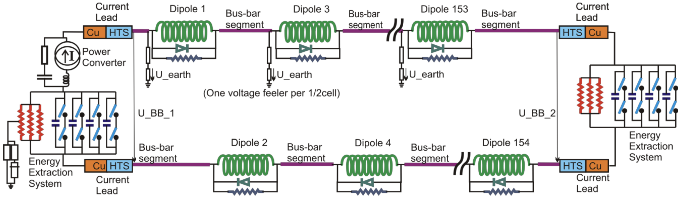
Manual Feature Engineering
Classification of oscillations after secondary quenches
-2
0
150
-1
1
151

Slide 26
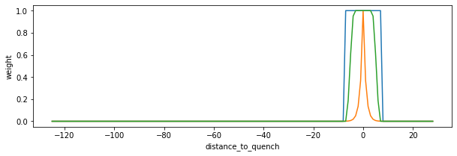
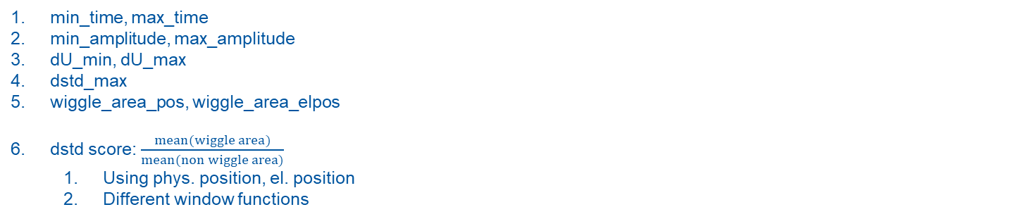
Manual Feature Engineering
2
3
4
2
3
1
min_time, max_time
min_amplitude, max_amplitude
dU_min, dU_max
dstd_max
wiggle_area_pos, wiggle_area_elpos
dstd score: $\frac{mean(wiggle area)}{mean(non wiggle area)}$
Using phys. position, el. position
Different window functions
5
5

Slide 27





1. Oscillation that only propagates electrically
Reason: electric coupling?
2. Oscillation that propagates physically and electrically
Reason: electric coupling through grounding?
Special case: Oscillation in only one magnet
3. Oscillation due to another quench in time window
Reason: coupling of magnets
4. Oscillation due to acquisition
Reason: acquisition
Manual Threshold

Slide 28

Find Probabilities
Wiggle: How does the dstd score evolve in B28L8, compared to other magnets
Probabilistic

Slide 29



2. U Diode Primary Quench
U Diode PM
1st Energy Extraction
Frequency Domain

Slide 30




Sunglass Threshold
Effect threshold to #quenches.
Filter: 20ms moving average

Slide 31




Frequency Domain
Calculate real valued FFT out of scaled input for all magnets.
Scaling: $x_{scaled}=\frac{x−mean\left(x\right)}{std(x)}$

Slide 32


2D-tSNE Frequency Domain
tSNE input: all maximal frequencies per magnet (events, frequency)

Slide 33

2D-tSNE Frequency Domain
tSNE input: all maximal frequencies per magnet (events, frequency)

Slide 34

2D-tSNE Frequency Domain
tSNE input: all maximal frequencies per magnet (events, frequency)

Slide 35









Finding concepts – tSNE overview
Example: Project 2D space to 1D space
2D space
1. Mapping distance between all points to distribution
1D space
Random initialization
Mapping distance between all points to distribution ($σ_{i}=\frac{1}{\sqrt{2}}$)
Distributions of 2D space should be similar to 1D space -> Minimize sum of all KL-divergences
KL-divergence
$$min⁡C$$
Classic Machine Learning

Slide 36





Finding concepts
Find different concepts of different anomalies in data
Example: Concepts in EE plateaus of U_diode PM
2D-tSNE axis 2
2D-tSNE axis 1
Classic Machine Learning

Slide 37
2. U Diode Full Quench

Slide 38


Predict parameters
a.) Neural netlist optimization: Improve simulations with gradient descent
b.) Predict fast secondary quenches with CLIC approach: Use Explainable AI to see what the NN was looking at
Discriminative Deep Learning

Slide 39


Generate data
Can ML generate data faster/more accurate than simulations? Using the same input
Optimization of decoder weights with MSE between real data and simulated data
Advantages:
Decoder can create within seconds, more similar to real data
Detection of anomalies with MSE
Disadvantage: Black box
Generative Deep Learning

Slide 40


Generate data
Can ML generate data faster/more accurate than simulations?
Generative Deep Learning

Slide 41
Discussion
Feature analysis:
Analyze both EE sunglasses, dependent on threshold, also within event
Find probabilities:
How does the dstd score evolve in B28L8, do other magnets evolve similarly?
Find concepts:
tSNE per magnet, look at frequency domain
Predict parameters:
Optimization of magnet parameter, research PSPICE optimization techniques
Generate data:
Simulation data will be improved
Check data integrity: sum of all u diode signals + ee signals should be 0
Also use: UQS0, Voltage feelers, Quench heaters
Genetische Optimierung,

